Slide 1

Ensure Student Success
Yiyi Wang
June 2019

Slide 2
Agenda
Objective
Analysis
Recommendations
Student Body

Slide 3

Objective

Slide 4
objective
How to ensure student success?
Define Student Success
Student success Metrics
Enrollments
Retention Rate
Graduation Rate
GPAs
Specific Test Pass Rate
…
Course Grade
Credits per Semester
Degree Conferred
Student Satisfactions
Career and Earnings

Slide 5
objective
What’s available in our dataset? What’s the most relevant?
480 unique records
17 variables
*No missing value
“Students’ Academic Performance"
Demographic
Academic
Student Behavior
Parent
Gender
Education Stage
Grade Level
Class
Topic
Semester
Raise Hand
Visit Recourses
View Announcements
Discussion Groups
Student Absence Days
Parent Answering Survey
Parent School Satisfaction
Relation
Nationality
Place of Birth
Section
Education Stage includes lower level schools, middle school, and high school
Grade level includes levels from G-02 – G12.
Class includes three categories low, middle and high level based on students’ grade/mark.
Topic includes programs/courses such as IT, Spanish
Student Absence Days includes two categories: above 7 times and below 7 times
Relation: parent who are responsible for the students, including father and mother
Low-Level: interval includes values from 0 to 69,
Middle-Level: interval includes values from 70 to 89,
High-Level: interval includes values from 90-100.”
Rename Class => Grade

Slide 6
Objective
Targeted group:
Students who have low-level grades.
Quantified objective :
To decrease overall percentage of students who have low-level grades by X percentage point* in the next academic year*.
*Discussion items
Assumptions
The quality of students remain consistent year over year.
The difficulty level of the same course remain consistent year over year.

Slide 7

Overview of the Student Body

Slide 8
Student Academic Performance Dataset
Students’ Academic Performance Dataset
Demographic
Academic
Student behavior
Parent
Gender
Education Stage
Grade Level
Class
Topic
Semester
Raise Hand
Visit Recourses
View Announcements
Discussion Groups
Student Absence Days
Parent Answering Survey
Parent School Satisfaction
Relation
Nationality
Place of Birth
Section

Slide 9

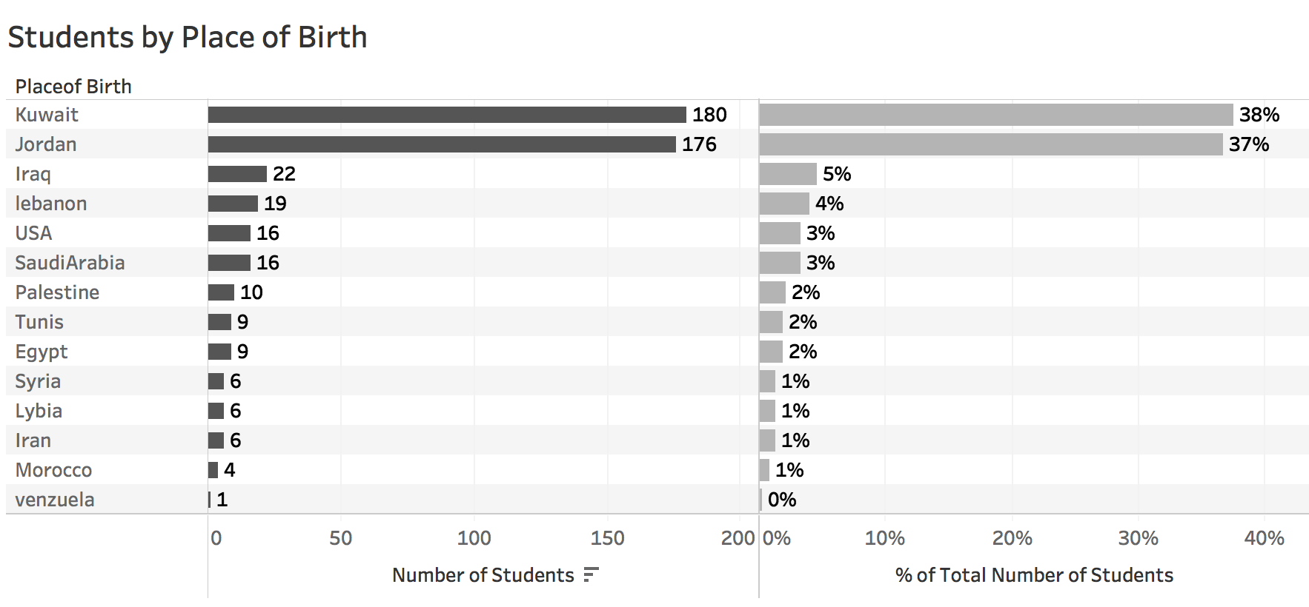
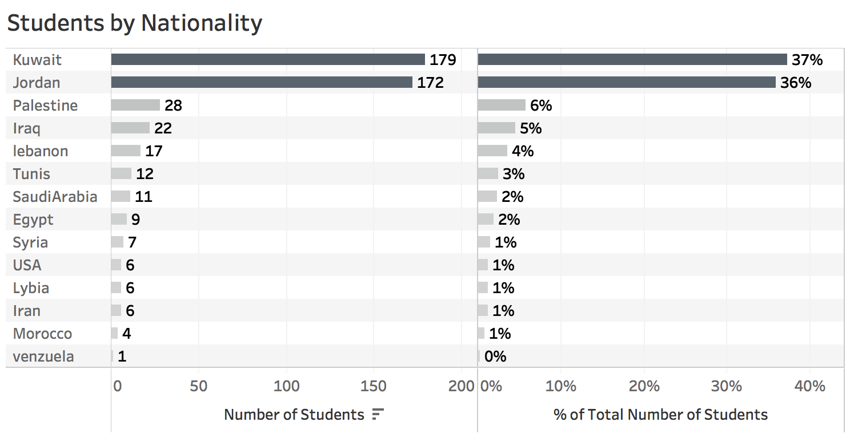


Overview Of The Student Body - Demographic
480 Students
14 Countries
73%
75%
Bottom line
We’re not going to form strategies or separate students based on demographical information.

Slide 10
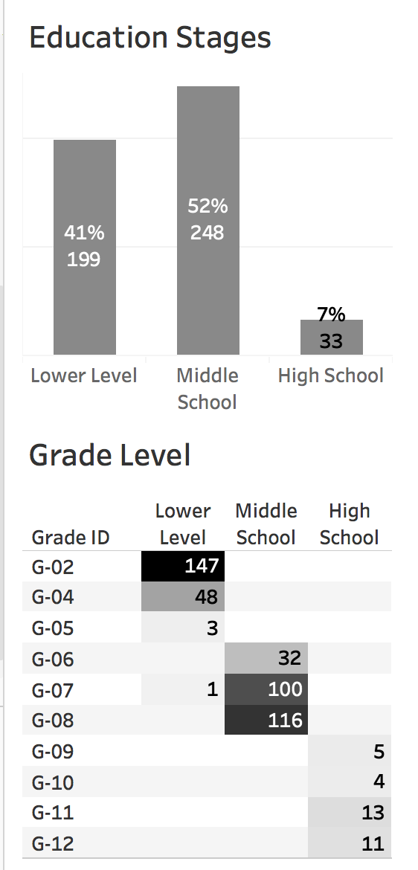
Overview Of The Student Body - Academic
74%
98%
24%
40%
87%
47%
93%
Findings
1. The proportion of first-semester and second-semester students are even.
2. 93% of our students come from lower-level schools or middle schools.
3. Education stages and grade level are connected, meaning lower level students are placed at lower level grade. But we do notice a few outliers.

Slide 11
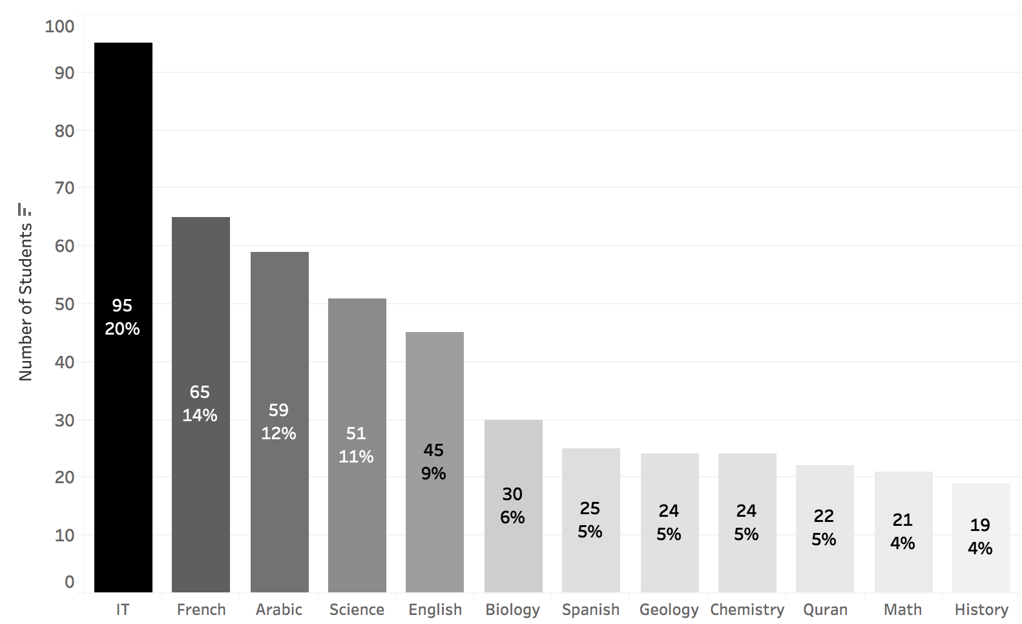
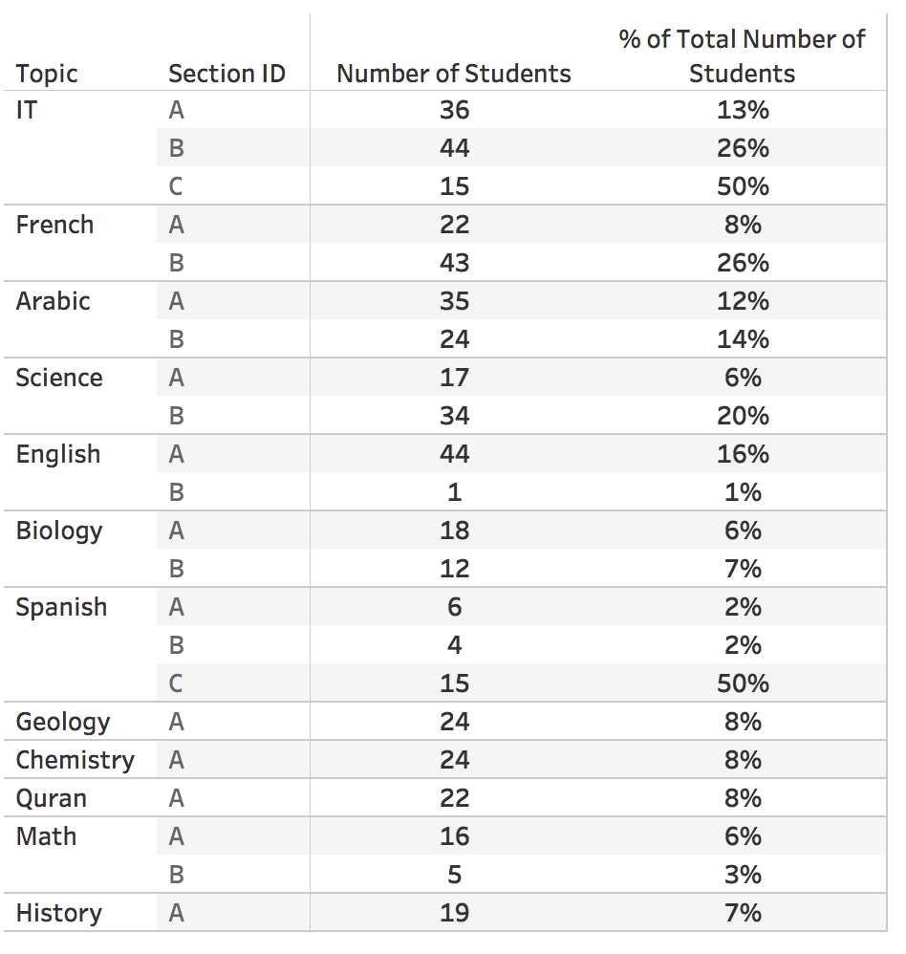
Overview of the student body - Academic
Number of students by Topic
12 Topics
Number of students by Topic and Section
Findings
1. IT is the most popular topic, followed by language related courses.
2. Class sizes vary by topics

Slide 12

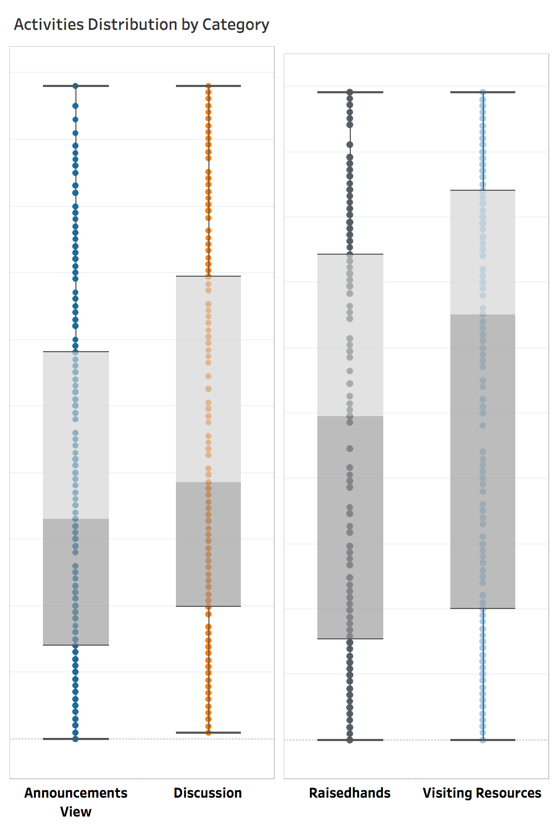
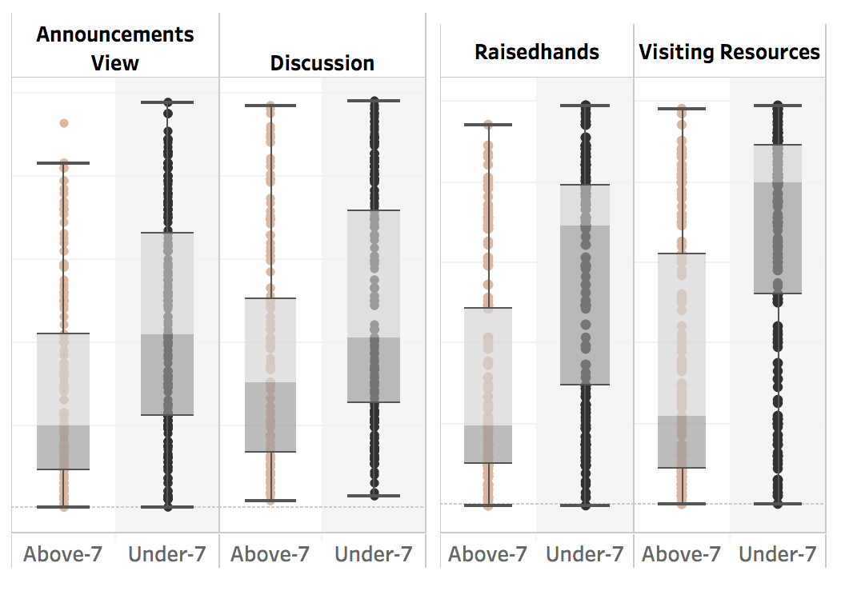

Overview of the student body - Student behavior
Student Activities
Student Absence & Student Activities
100
100
Median:65
50
Number of activities
Number of activities
39
33
0
0
Student Absence Days
Findings
1. Visiting resources is the most popular activity, followed by raising hands and having discussions.
2. Class attendance is positively related to student activities.

Slide 13
Overview of the student body - Parent
Answering Survey & Satisfaction
Father
Mother
Although this information seems interesting, it is hard to tell whether any of these would lead to students’ lower level grades. It could be that the students received lower level grades first and then parents provided the satisfaction results.
Thus, we’re not going to consider all parents related info in this analysis.

Slide 14

ANALYSIS

Slide 15
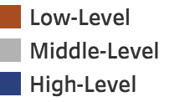

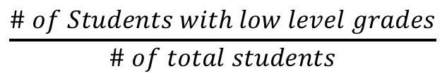
Standard/Benchmark
Fail Rate
$$\frac{\# of Students with low level grades}{\# of total students}$$
Benchmark
26% is the overall fail rate
Any category that has more than 26% fail rate will be considered as an area that needs improvement.

Slide 16
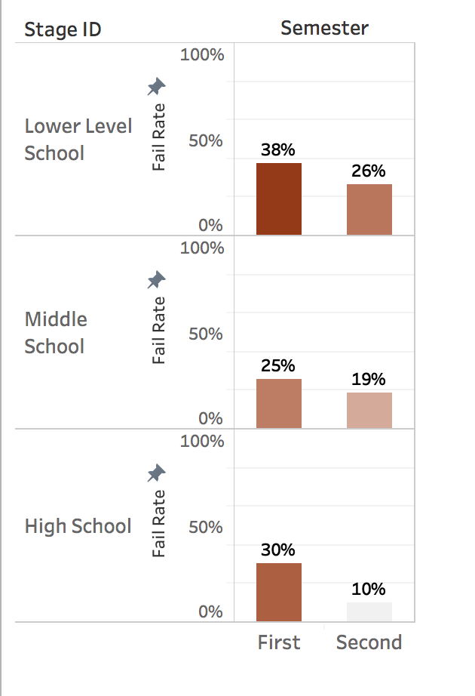
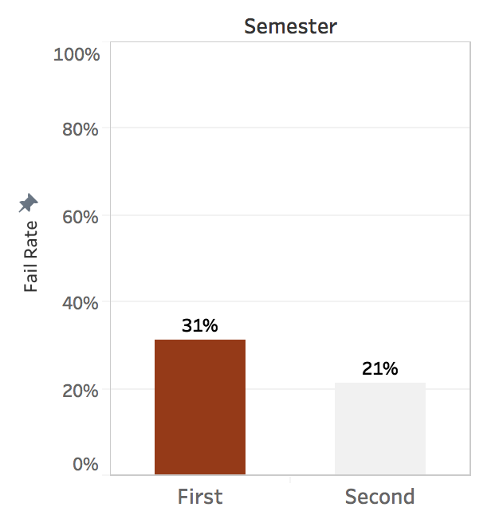
Fail Rate by semester
Fail Rate by Semester
Fail Rate by Semester and Education Stage
Findings
First- semester students had higher fail rate than the second-semester students, despite their education stage

Slide 17
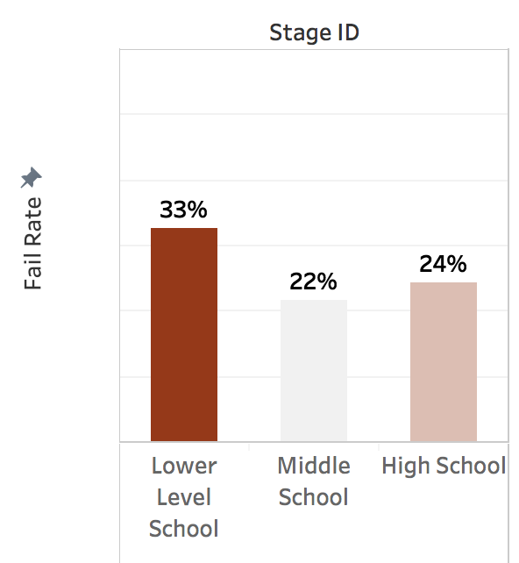
Fail Rate by Education Stages
Fail Rate by Education Stage
Low
Low –level grade
Middle
Low –level grade
High
Findings
1. Students who are from lower level schools had the highest fail rate.
2. Students from lower level schools failed when placed at higher grades

Slide 18
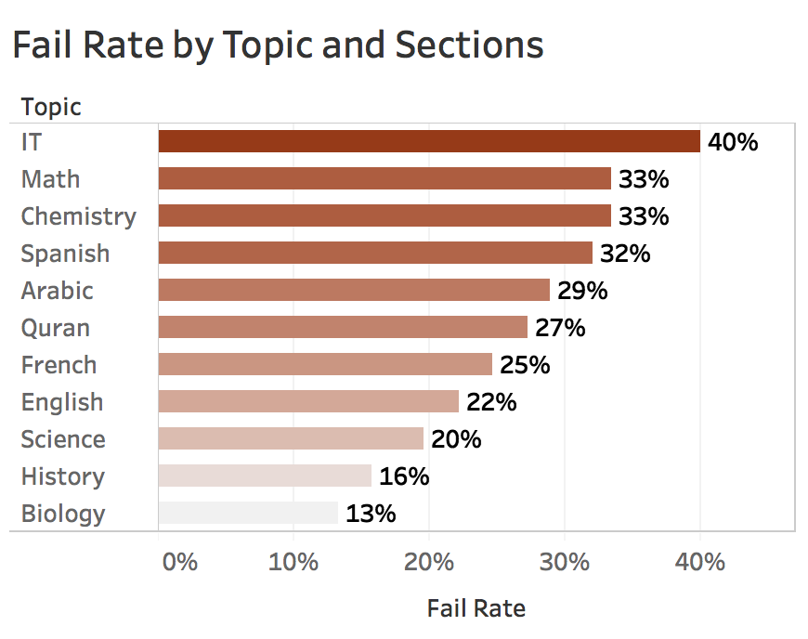
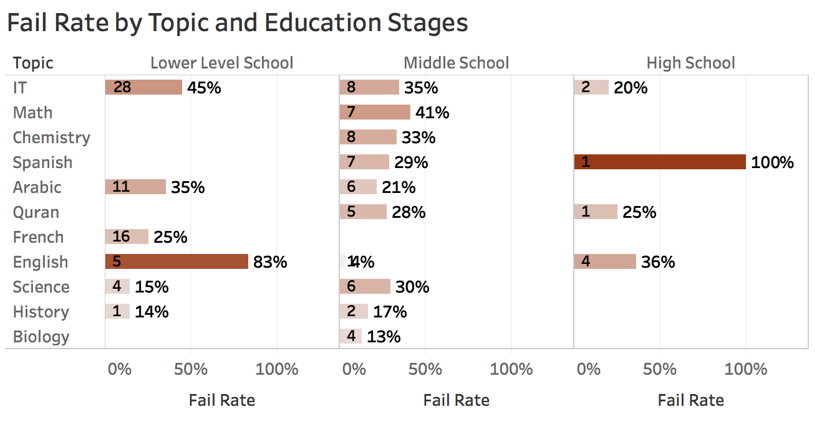
Fail Rate by Topic
Findings
1. IT course had over 26% fail rate among middle school and lower level schools.
2. In the English course, students from lower level grades had 83% fail rate.

Slide 19
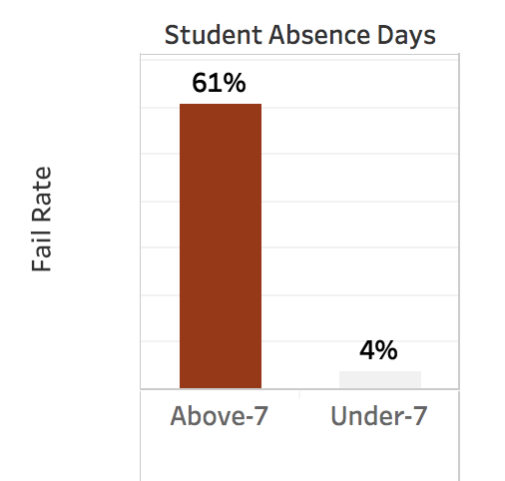


Fail Rate by students absence
Fail Rate by Class Attendance
Class Attendance by Grade
Findings
1. 91% of students who received low level grade missed more than 7 classes.
2. In contrast, only 3% students who received a high-level grades missed more than 7 classes.

Slide 20
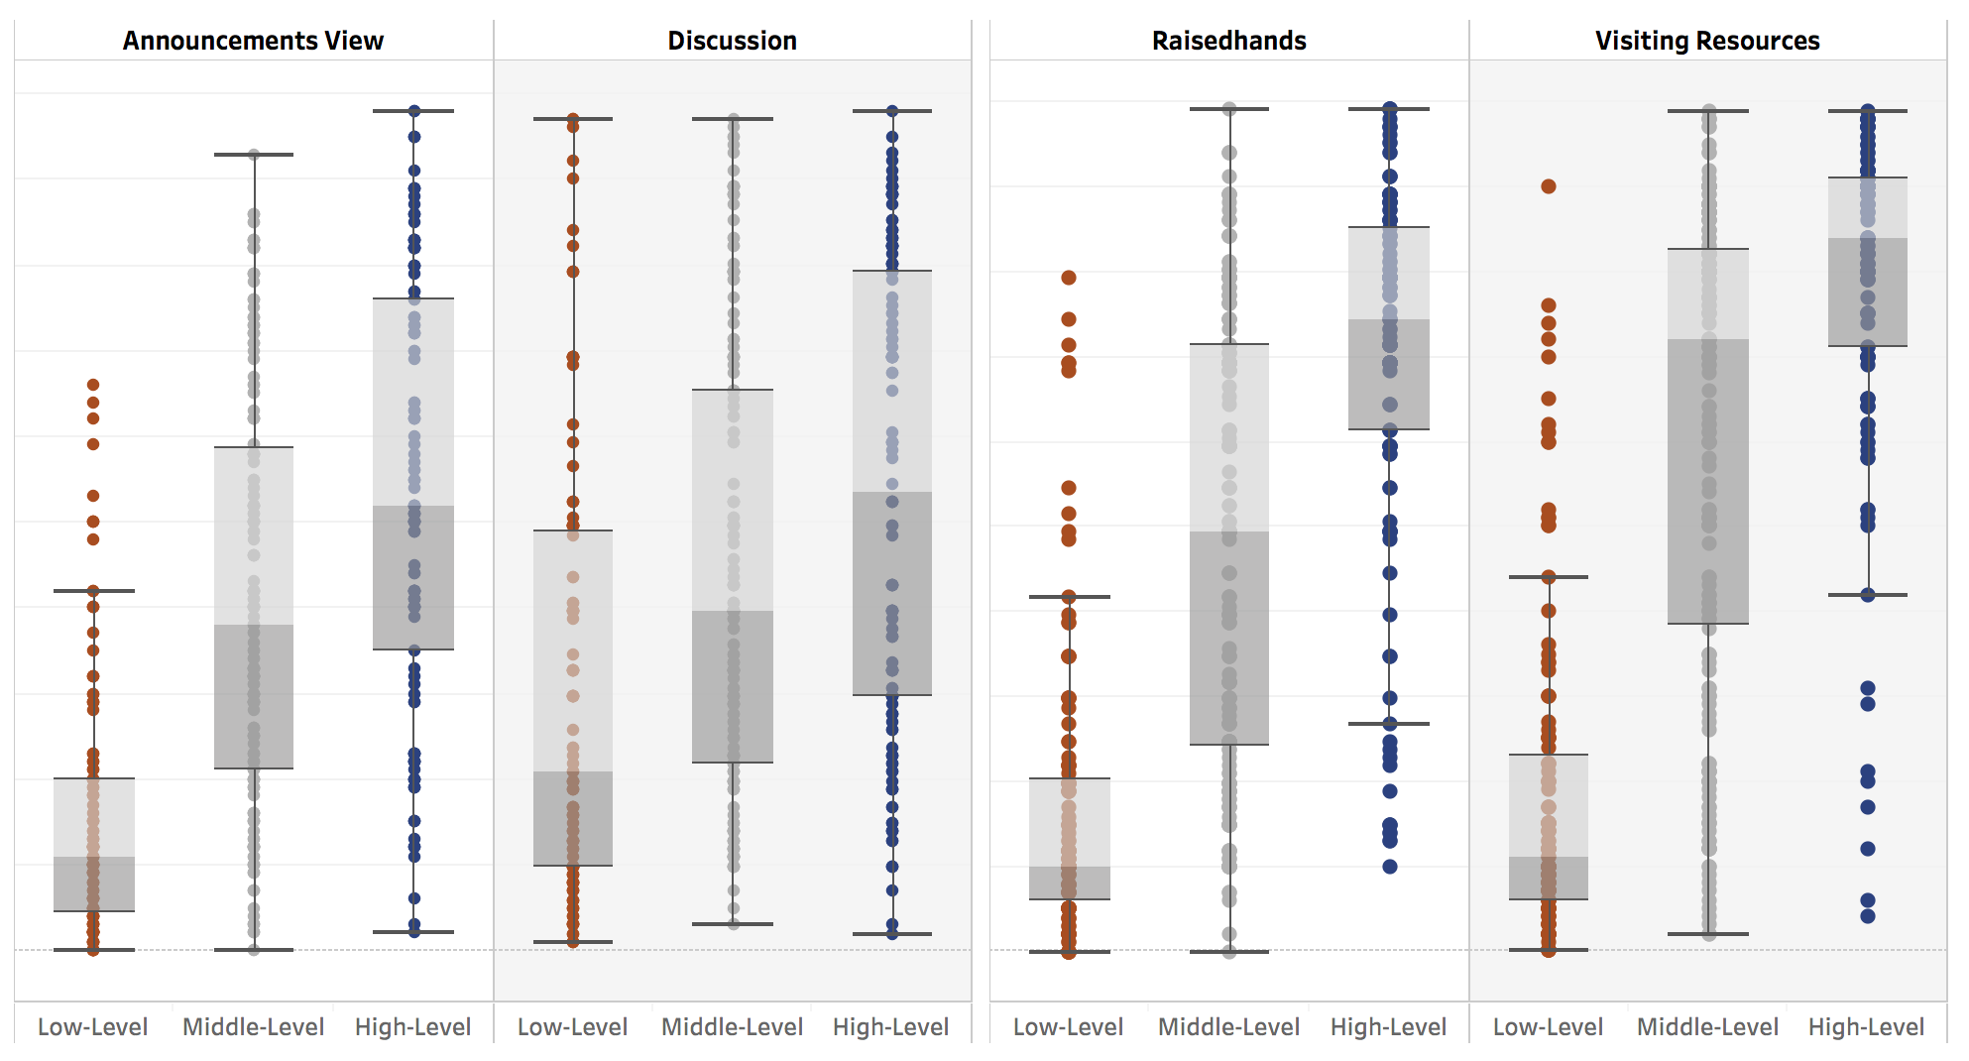
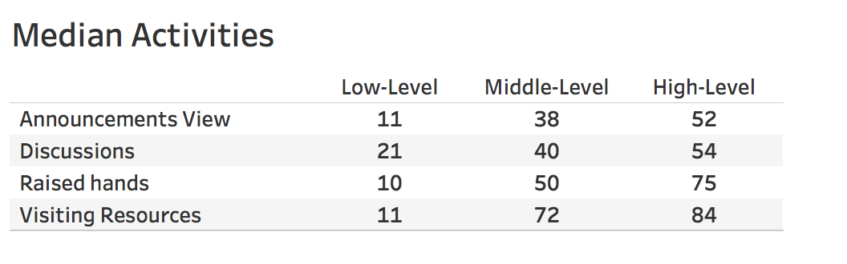
GRADE BY ACTIVITIES
100
Number of activities
0
Findings
Student engagement and grade are positively related.

Slide 21
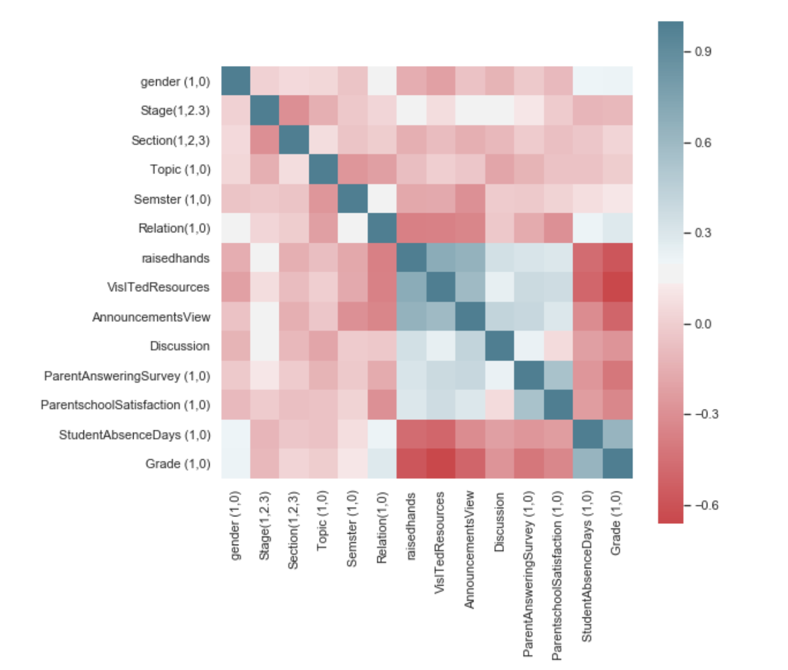
Verify the Findings
Method: Correlation Matrix
Essentially, the darker the color, the closer correlation between the two variables.
Red = negatively correlated
Blue = positively correlated
Grade (0,1)
1 = Low level grade
0 = Not Low level grade

Slide 22
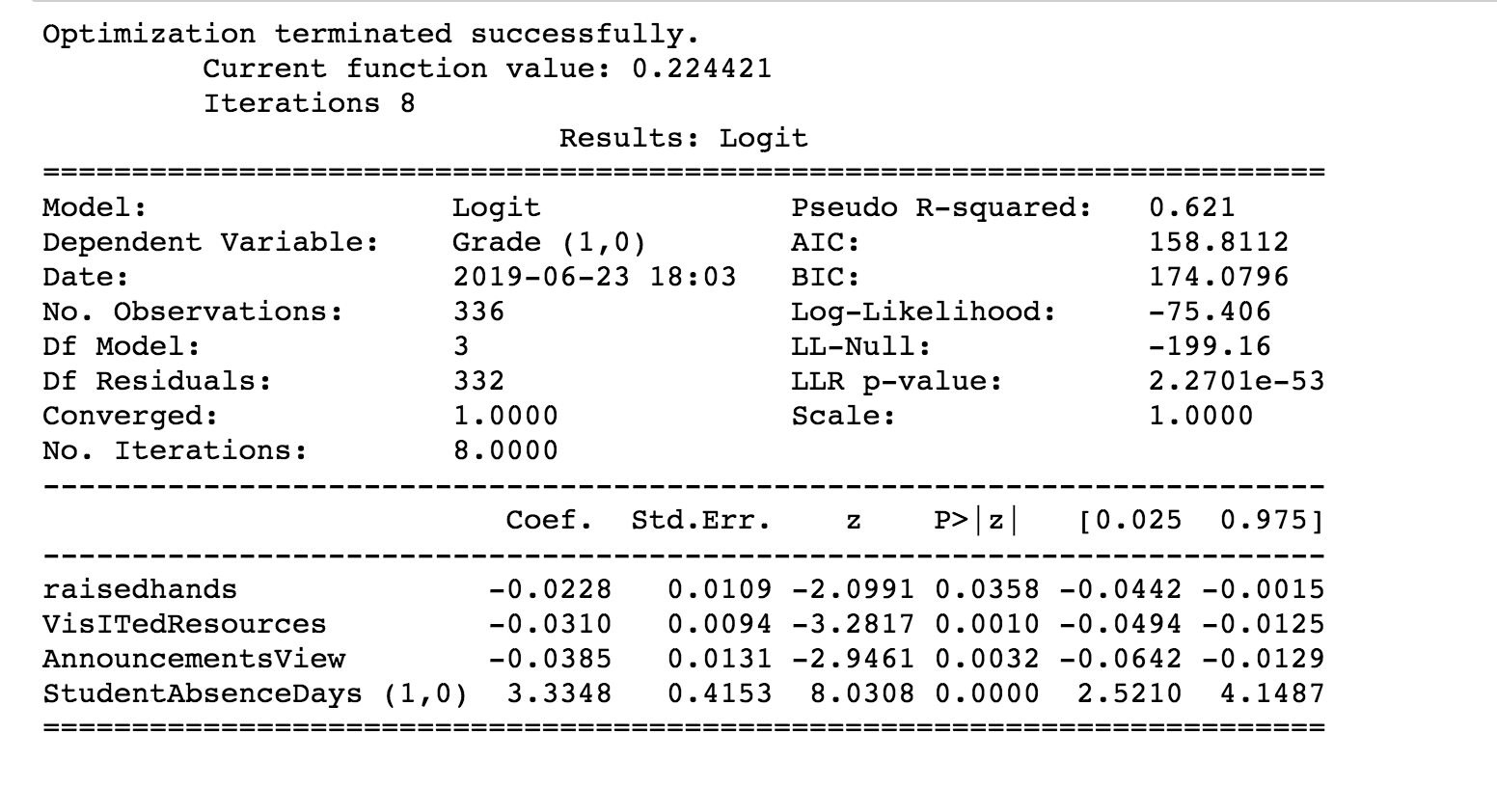
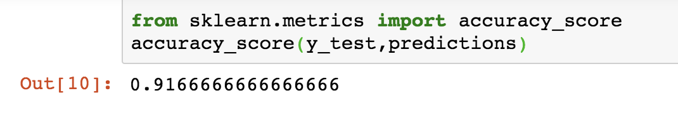
Verify the Findings
Method: Logistic Regression Projections
Y = Grade (1,0)
1 = Low level grade
0 = Not Low level grade
Student Absence Days (1,0)
1 = Above 7
0 = Below 7
P value <5% = statistically significant
Accuracy score = 91.6%
Conclusion
Students' grades are correlated with students’ class attendance and student activities.

Slide 23

Recommendations

Slide 24
Recommendations
Top Priorities
Courses
Advising
Data

Slide 25
Recommendations - Top Priorities
Make Student Success as a Top Priority
Create implementation documentations and scorecards to track progress towards the goal.
Build and maintain collaborative relationship, especially between the Office of Advising and faculties.
Open conversations across the organization to encourage student success ideas and innovations across campus.
Clearly define student success goal for the organization and each department.

Slide 26
Recommendations - Top Priorities
Set up attendance policy and clearly communicate the consequence of class absence to our students in the very beginning.
Mandate class attendance among first-semester students or students from lower level schools
Follow up with students who missed more than three classes before the mid-term immediately and consistently.
Enhance Engagement
Ensure opportunities for students to collaborate and encourage group discussions in the classroom.
Reach out and provide academic support, resources to students who frequently missed classes or seldom participate in and outside the classroom.
Class Attendance Policy
Clearly define the expectation of the course, provide sufficient academic support and offer frequent feedback and assessment to the student.

Slide 27
Recommendations – Courses
Identify and Eliminate Curricular Bottlenecks
Review course curriculum and materials to makes sure the difficult level is reasonable, such as IT courses.
Prepare Students for Success
Set up pre-requisite courses when needed.
For language related courses such as Spanish, English, provide entry level courses or request students to pass language based tests before enrolling.
Provide time management, study skills trainings and mentoring programs into lower level course.

Slide 28
Recommendations - Advising
Implement Robust Academic Advising Management Policies and System
Ensure easy access for students to schedule advising appointments.
Mandate advising sessions for first-semester students.
Provide step-by-step instructions for registering classes and evaluating course materials.
Provide Additional Support to the Targeted High-Risk Students
Develop timely, effective, and personalized communication strategies to this group of students, offering support in course selections, academic development and other trainings when needed.
Encourage peer-led study groups.
Increase opportunities for mentoring and coaching.
Provide timely tutoring services before students fall too behind.
Work with faculties to set up a user-friendly way for to record and track attendance, performance, engagement.

Slide 29
Recommendations - Data
Define
Clearly define key student success metrics for the institution and for each department.
Form
Form a data-driven culture that support and inform student success strategies.
Collect
Collect, capture and optimize data points and structure.
Develop
Develop predictive models to identity students at risk.
Communicate key findings to relevant stakeholders on a regular basis to drive data-driven decisions.
Identify
Identify risk factors and provide early alerts via flag system
Communicate

Slide 30

Q&A
Thank you!

Slide 31
Citation
Amrieh, E. A., Hamtini, T., & Aljarah, I. (2016). Mining Educational Data to Predict Student’s academic Performance using Ensemble Methods. International Journal of Database Theory and Application, 9(8), 119-136.
Amrieh, E. A., Hamtini, T., & Aljarah, I. (2015, November). Preprocessing and analyzing educational data set using X-API for improving student's performance. In Applied Electrical Engineering and Computing Technologies (AEECT), 2015 IEEE Jordan Conference on (pp. 1-5). IEEE.

